Slide 1

Animal Shelter Trends
Taylor Woodington
Notes:
Hello all, today we will be discussing animal shelter trends. More specifically the outcomes of animals at shelters. So adoption versus non-adoption.

Slide 2
The Problem
Shelters experience an inflow of animals
Struggle for adoption
What are the important factors that affect the time of adoption for animals?
Notes:
For shelters, they often experience an inflow of animals and while some get adopted quickly, others take a long time or maybe never get adopted. Today we are going to see if there is a way to help shelters recognize the factors that are affecting longer adoption periods .

Slide 3
Background
Austin Animal Center Shelter
Age of the animal
Type of animal (Cat/Dog)
Breed
Outcome of Adoption
Known Gender (Spayed/Neutered
Notes:
In order to understand this problem a little better, we are going to dive deeper into a dataset from the Austin Animal Centers Shelter. This shelter is the largest no kill animal shelter in the United States and could raise areas of focus or questions for other shelters to investigate. The dataset includes the age of the animal, type of animal, breed, the outcome of adoption... meaning adopted, transferred to another shelter, returned to owner and more, as well as the known gender, those without spay or neuter have been considered unknown under the gender understanding in the dataset.

Slide 4
Preparation and Methods
Remove unnecessary columns (i.e. individual id, animal name,, DOB, etc.)
Adjust age units for better useability
Remove missing values
EDA and Visualize
Linear Regression Model: Adoption vs. Age
Visualize Number of Adoptions made for the months of a year
Logistic Regression for top influencing factors
Notes:
In order to prepare this dataset for analysis, I removed unnecessary columns which were not used and just creates cluster, adjusted the age to all be in years for easier use and understanding, and removed values to ensure no bias by using averages.
After the preparation I explored the data by visualizing the distribution of ages, outcome types, and most common breeds. The average age of the dataset was 2 years old, the most common outcome was adoption, then transfer, and the most common breeds in the shelter were domestic shorthair mixed cats, and pitbull mixed dogs.
Following the EDA, I created a few models to better understand the relationships in the data. The first is a linear regression model of adoption vs. Age, a visual for adoptions throughout the year and common breeds, and a logistic regression for top influencing factors on adoption.

Slide 5
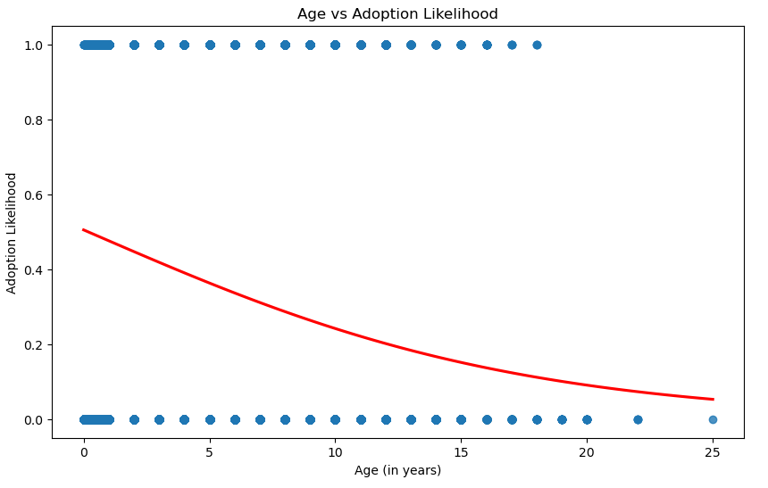
As Age Increases, Adoption Likelihood Decreases
Notes:
The first model made was a linear regression model to see the relationship between age and likelihood of being adopted. Here we can see age plays a large factor on adoption where age increases, the likelihood of adoption does decrease.

Slide 6
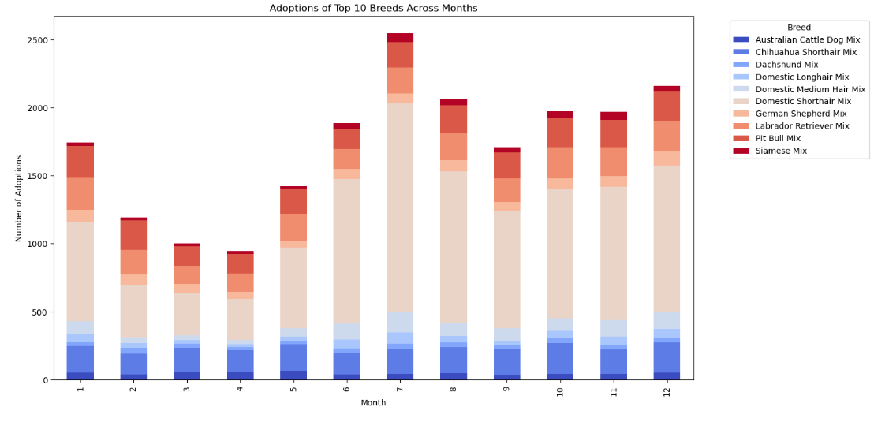
Domestic Shorthairs are the most adopted breed through every month of the year.
Notes:
Moving to this visual, we can see overwhelmingly that domestic shorthairs are the most adopted breed through every month of the year with more adoptions occurring in the second half of the year, possibly due to the holidays.

Slide 7
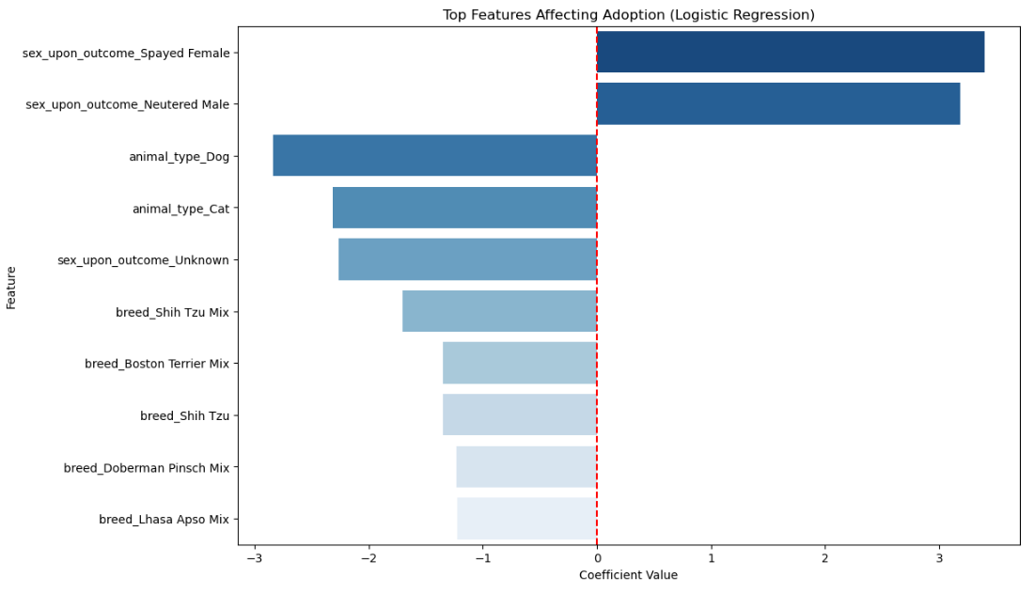
Whether the animal is spayed/neutered affects adoption.
Notes:
Finally with the larger model presented here it is a logistic regression model of the top features which affect adoption for an animal. For this model We can see that the animals that were spayed or neutered had a positive relationship with adoption. This may be due to a decrease in medical bills and unnecessary reproductive issues.

Slide 8
Conclusion and Assumptions
Animals Age is an important factor
Unsurprising results
Limitations and Challenges:
Austin Animal Center is a no kill shelter
Unable to see shelters across the nation
Notes:
With all of the analysis being done we can conclude that age is an important factor of adoption along with whether or not the animal is spayed or neutered. This is not a surprise because it is a common thought, as seen in other research articles such as one from the National Library of Medicine it is common for these to be reasons animals do or do not get adopted.
While these answers in analysis are useful, it is not ethical to consider it as an answer for all shelters. Austins Animal Center is a no kill shelter so the factors that play in at a shelter under different regulations may not apply. We cannot see the relationships with shelters across the country so more shelters need to be analyzed in the future.

Slide 9
Future Recommendations and Implementation
Ethical Inclusion
Compare shelters that does and does not have the no kill regulation
Recommended
All shelters to analyze data when it comes to older cats and dogs
Promote
Make promotion plans for older animals
Additional Program
Spay/Neuter Programs
Notes:
In the future there should be more consideration of other shelters. This was to prompt areas of interest for other shelters to focus their data on. I would recommend for more shelters to analyze their data when it comes to older cats and dogs and their adoption status. In order to assist with those older animals, there can be medical promotions.
Shelters can partner with local veterinary hospitals to create a deal which decreases the cost of veterinary visits or medical casts of the animal. This will bring business into that specific veterinary hospital but also promote the adoption of these animals by decreasing the financial burden.
In addition to this Spay/Neuter programs can help decrease the amount of kittens that come into the shelter which increases the adoption chances of the older animals by reducing options as well as decreasing medical costs to those adopting.
While there is a lot of work to be done, I believe this can start to pave the way for future adoptions at shelters.

Slide 10
References
AaronSchlegel. (2018, February 16). Austin Animal Center Shelter Outcomes. Kaggle. https://www.kaggle.com/datasets/aaronschlegel/austin-animal-center-shelter-outcomes-and/data
Hawes, S., Kerrigan, J., & Morris, K. (2018, March 7). Factors informing outcomes for older cats and dogs in animal shelters. Animals : an open access journal from MDPI. https://pmc.ncbi.nlm.nih.gov/articles/PMC5867524/
Publisher data.austintexas.gov. (2024, November 25). City of austin - austin animal center outcomes. Catalog. https://catalog.data.gov/dataset/austin-animal-center-outcomes

